Slide 1


GCSE Curriculum Choices Evening at Becket Keys
Please sit together as a family

Slide 2


The purpose of the evening:
To inform you about the GCSE subject choices at Becket Keys
To inform you about the process of choosing options

Slide 3


Notes:
PRAISE THEM - great year group, getting better all the time, strong academically. Hopefully you heard lots of positive messages at recent parents evening. Students are doing well across the curriculum and really working hard in lessons and with their homework. We have very high expectations of this year group at GCSE.

Slide 4
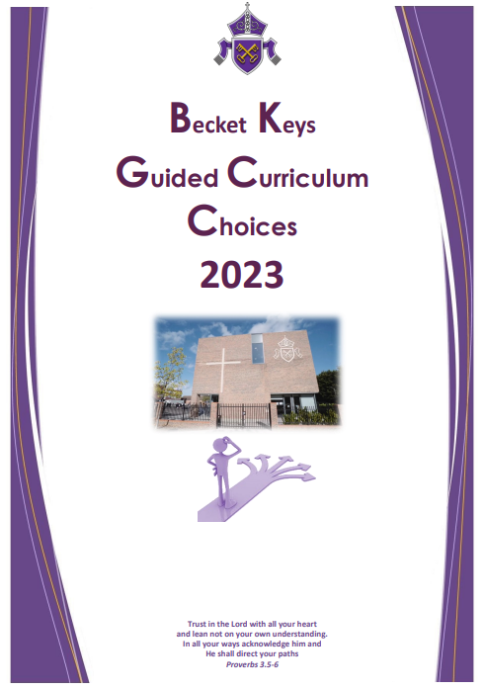
Year 9 Guided Choices Booklet
Notes:
Where can parents find information regarding choosing GCSE subjects? The first port of call is the Year 9 Guided Curriculum Choices guide. This was sent to you last week.
At the front – foreword from Mr Scott-Evans, which contains many of the messages I will talk through and explain in more detail this evening. Information about how our curriculum is designed at KS4. Then pages from each department, with information about the courses at GCSE – exam boards, content of topics taught, how students will be assessed, relevant careers, sixth form entry requirements and much more. There are also some FAQs at the back of the guide, which includes key dates for the options process. Do take time to read the booklet carefully before making choices.

Slide 5
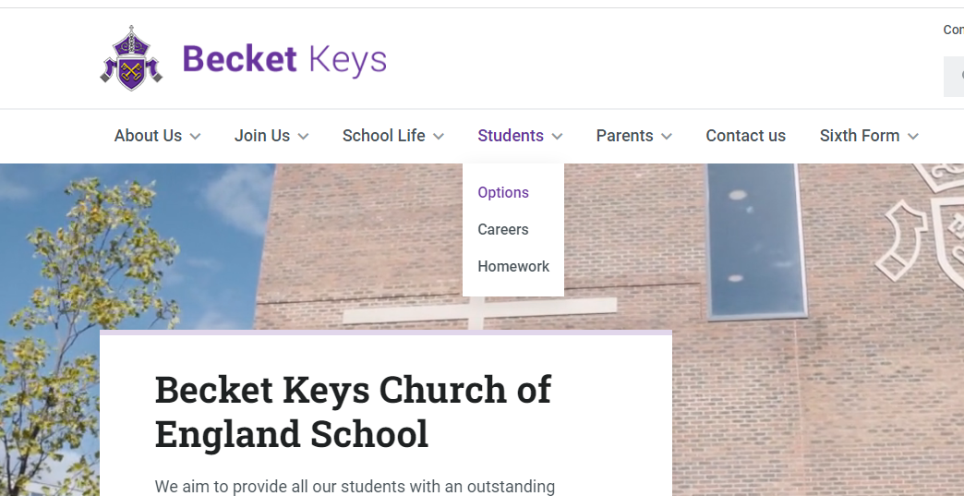
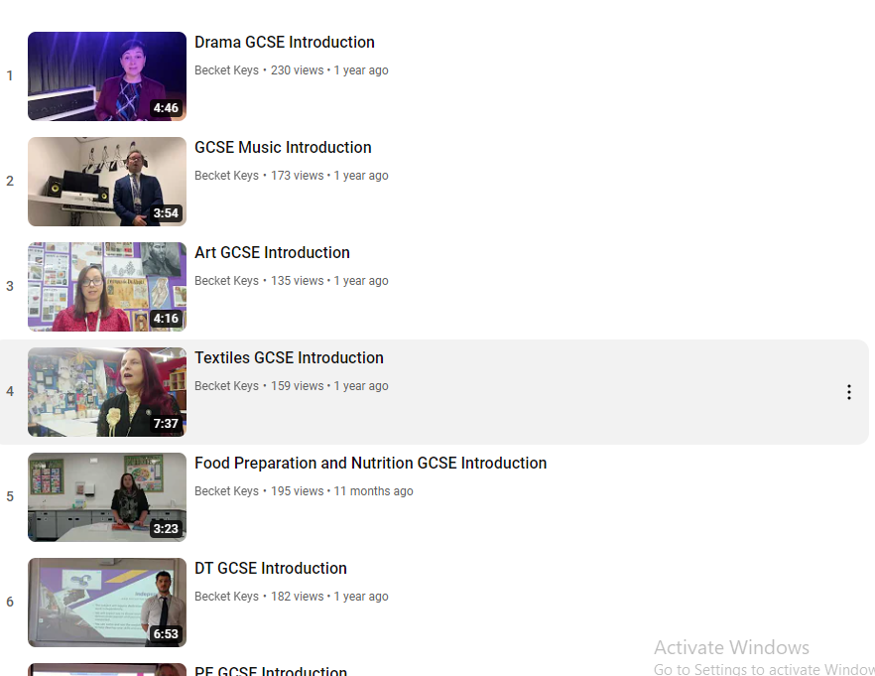
Options@becketkeys.org
Notes:
The website. Students – Options – Option page. Here you will find short videos from our Heads of Department of options choices. In these videos, subject leaders will talk you though what the GCSE course is like in their subject as well as information about how students are assessed. Please watch them to help you to make your decisions. You can also access the options email address from this page. Any queries about option choices should be directed here.

Slide 6

Notes:
Parents' evening and the recent interim reports should have given you an indication of which subjects might be suitable for you. You might be surprised that at the recent Parents' eve teachers were not 'touting for business'

Slide 7




KS4 at Becket Keys -
A traditional curriculum
Notes:
So before we begin talking about the options process, I would like to talk to you about our KS4 Curriculum philosophy
We aim to be very selective in our choices of subject and make sure that those courses are of high quality and offer the best chance of success. We would prefer to offer fewer subjects, with expert teachers teaching them. This leads to strong results for students.
We focus, unashamedly, on the core academic subjects and our offer in the arts. Becket Keys has incredibly strong design, music and drama departments and the arts are flourishing here.
We want to offer a curriculum that will best prepare our students for life beyond school.
We want to offer a curriculum which will keep the most doors open for students in the future. We want to prevent students from taking subjects now that will hinder them later down the road, and part of that is our aim to enable as many students as possible to ultimately gain places at good universities.
As a result of our philosophy, we don’t offer a huge range of vocational subjects.

Slide 8

The EBacc subjects
English Language and Literature
Mathematics
The Sciences
Geography or History
A Language (Spanish or Mandarin)
To achieve the EBacc students must study at least seven GCSEs in the five areas
Notes:
I mentioned that we believe in offering students a strong suite of academic subjects. You may have heard of the EBACC or English Baccalaureate. We advocate the EBACC at Becket Keys because it aligns with our philosophy at Becket Keys so well.
WHAT IS THE EBACC?
The EBacc is not a qualification in its own right – it’s a combination of GCSE subjects, including a language, that offer an important range of knowledge and skills to young people. Students must achieve at least a 4 in all subjects listed above to achieve. Universities and prospective employers will of course look at the grades you got at GCSE, but they will also look at the subjects you studied. The Ebacc provides students with a broad and balanced academic curriculum and is recommended by the Department for Education and Government.
EBACC FUTURE PROOFS YOUR CHILD’S PROSPECTS
While your child may not have decided on their future career path yet, choosing the EBacc at GCSE gives them access to a full range of employment options when they leave secondary school and the broad knowledge that employers are looking for.
If students are thinking of going to university, the EBacc is also often recommended by Britain’s universities.

Slide 9

Notes:
LANGUAGES GIVE YOUNG PEOPLE A COMPETITIVE EDGE
Current changes to GCSE language specifications mean that a language GCSE qualification will be accessible to an even greater number of students.
Cognitive development and academic achievement across all subjects (stimulates the brain and improves memory recall and retenion and improves non-verbal reasoning skills - maths), cultural awareness/curiosity and an improved global perspective , communication skills, and career opportunities. More degree courses and apprenticeship schemes are asking for a language than ever before. It sets students apart from the competition.

Slide 10
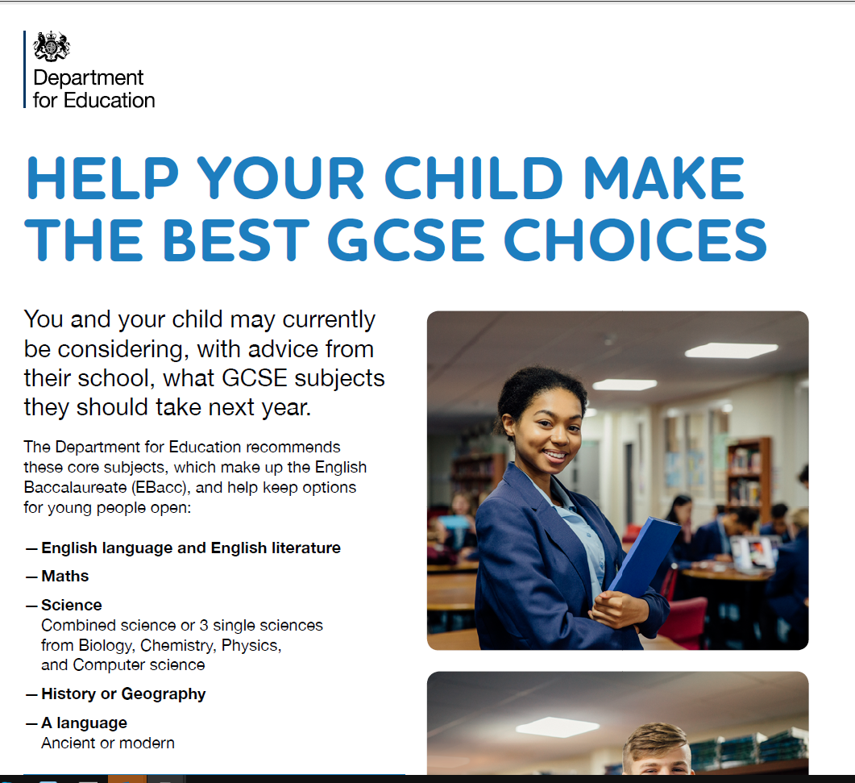
Notes:
The link for this leaflet can be found in the letter sent to you with the Curriculum Choices booklet. It contains addition information from the DFE about the importance of the EBACC.

Slide 11
Core Subjects
Subject | Lessons per week
English (GCSE Language and GCSE Literature) | 5
Mathematics | 4
Science | 6
Core PE (no qualification) | 2
PSHE | 1
Notes:
So let’s now talk about the process and how the curriculum is structured at Key Stage 4 (Years 10 and 11)
English Language and Literature are two separate GCSEs with different specifications. The grade that students can achieve in each is entirely independent of the other. So a student can achieve a 7 in English Literature, and a 5 in English Language. There are 5 English lessons per week – 2 of these are dedicated to Language, which is largely a skills based GCSE. 3 lessons are dedicated to Literature, where students have to study and learn a range of set texts before the GCSE exam.
All students have 6 lessons of Science per week. At the end of year 10, the most able scientists will be selected to do triple science (which is a separate GCSE for Physics, Chemistry and Biology). This decision is made by looking at how well students have achieved across year 10 and in their end of year 10 exam. All other students will take the trilogy route (or combined science as it has been known in the past). This means that students will gain two GCSEs in ‘Science’ which are tethered together. A student might get 6/6, or 6/5, or 5/4. The grades are never more than one grade apart. Whether students are doing triple or trilogy, they will still have 6 lessons of science per week.

Slide 12
Compulsory Subjects
Subject | Lessons per week
Religion and Philosophy | 3
History OR Geography | 3
Spanish OR Mandarin (OR Hospitality and Catering with French) | 3
Other ‘free choice’ subjects | 3
Notes:
Some setting in Languages

Slide 13

Compulsory subjects = 8/9 GCSEs
One further subject to be chosen
Students will gain 9 or 10 GCSEs in total.
Notes:
At sixth form, we require 8 GCSEs at grade 4 or above (with a 5 in both English Language and maths). So students can select their best 8 GCSEs to ensure entry to our sixth form.

Slide 14
Core Subjects | One of (Humanities) | One of (Languages) | Plus
English | History | Spanish | One Free choice
Maths | Or | Or
Science | Geography | Mandarin
RP |  | Or
Core PE |  | Hospitality and Catering with French
Notes:
Hospitality and Catering – we have a small number of students not studying a language in year 9 – these students will take Hospitality and Catering with French. We think it’s important that all students study a language in some form, so this is why students not taking a language GCSE are required to do this course. The language element will consist of learning French phrases that are used in many kitchens and restaurants.

Slide 15
Final Option Subject (3 lessons per week)
Geography
History
Music
Drama
Physical Education
Computer Science
Art, Craft and Design
Textile Design
Design and Technology
Food Preparation and Nutrition
Business
Notes:
GFE - These are the subjects that are being offered in 2023.
Business is a GCSE that students will not have studied at Key Stage 3. It will be very important to watch the videos on the webpage about these subjects if you are thinking of taking them. There is often a lot of initial interest in new subjects, because they are ‘new’. However, our advice is that students continue with subjects they are already enjoying studying, have already put a lot of hours and effort into and have proven success in, rather than start a new subject. Students who are not experiencing success in any of the subjects they are already doing might consider starting a new course such as Business. Business is a classroom based subject where students will have to sit a formal exam. Business is not a facilitating subject. You do not have to have done Business at GCSE to do Business or Economics at A level. You need strong grades in Maths and English to study these subjects post GCSE.
Students need to do well in their Year 9 exams, and particularly in Maths to be accepted to the CS course. You should have an outside interest in programming or coding. There is an entry exam and bridging work to complete.
Hospitality and Catering is a vocational subject, rather than a GCSE. Students will achieve a Pass, Merit or Distinction on this course. Students not studying a language will automatically be selected for this course, but other students can also take it as a final option choice.

Slide 16

Art and Design
Textiles
Design and Technology
Food Preparation and Nutrition
PE
Music
Drama
Notes:
These subjects can be divided further into subjects which include a non-examined assessment and those which don’t. Non-examined Assessment or NEA is equivalent to coursework. Students have to produce a substantial piece of work to support their final examinations, and this is assessed in the classroom and moderated by the exam board. Students need to bear in mind the time commitment they will need to make in subjects that contain an NEA.

Slide 17
Non-NEA subjects
History
Geography
Computer Science
Business
Notes:
All these subjects are assessed by exam only, as the core and compulsory subjects are.
Think about whether you do better in project type work that you can do in your own time working to a deadline, or whether you do better revising for and completing exams. This might help you to choose.

Slide 18


Good reasons to choose a course
NOT good reasons to choose a course
I’m good at it and I achieve good marks
I have been studying it for the last three years and I know I enjoy it
It will make my lessons more varied
I really like the teacher
It’s new to me
All my friends are choosing it
It’s what I think everyone expects me to do
For a future career

Slide 19


Everyone must choose a reserve subject
Notes:
This is really important. We cannot guarantee that all students will get their first subject because this depends on timetabling restrictions and numbers of students choosing particular subjects. For this reason, you MUST choose a reserve subject that you would be happy to take if we are unable to accommodate your first choices. We will make decisions based on current attainment. Students need to be sure they are willing to take either their first choice or reserve. I have had instances where students have been given their reserve subject and they have said ‘but I don’t want to do that subject’. You must be prepared that you might not get your first choice. You must feel happy to take either subject. Remain positive about both subjects.

Slide 20


Notes:
Two purposes of this slide - it is time to decide, but you also have time to decide! Do read all of the information in the Options Booklet and watch the department videos. Discuss and take time to make the correct decision. It is very unlikely that we will be able to change your course once Year 10 has started.

Slide 21
Timeline
January | Parent Consultation Evening
February | Interim reports sent home (mid-year judgements)
February | Parent and student Curriculum Choices information evening
Friday 27th February | Deadline for students’ option choices to be submitted
July | Option choices confirmed after Year 9 exams. Year 9 exams are scheduled week beginning 30th June.

Slide 22
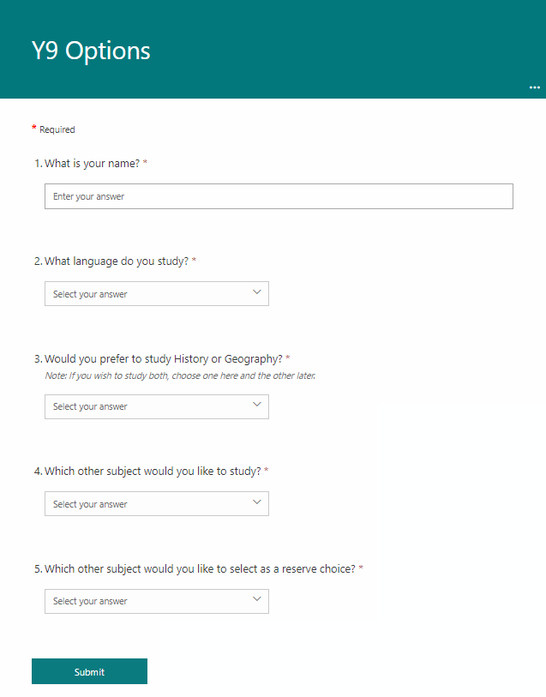

Options questionnaire
Notes:
So, how do you let us know the subjects that you want to take next year?
After the presentation this evening, Parents will be sent an email with a link this form. Parents then submit their responses by the deadline.

Slide 23

What happens if there are subjects that I want to study at A level that I can’t study at GCSE?
Notes:
Information about entry into our sixth form is contained in the option booklet. It is possible to take a subject at A level if you haven’t studied it at GCSE.

Slide 24
How do I choose my final option?
Notes:
We recommend that you choose a subject that you have been enjoying and doing well in for the last three years. Ask yourself - Do I like sitting in a classroom? Or do I want to be creative? Be active? Choose something you will enjoy as a contrast to your other academic subjects. You will have more time in classrooms at GCSE than you have ever had before. Consider your final choice wisely as an opportunity to vary your lessons. As an opportunity to do something completely different during your day.
Don’t start a new subject (unless you feel you have had little success in your other subjects) – pick a subject that you already like and have been doing well in. You have been doing some subjects for nine years! You don’t need Business GCSE to do it at A level.

Slide 25

Notes:
HOY - If you are the sort of person who gives up in Year 9 and stops working hard, you’re probably also the sort of person who will not bother with coursework and revision and hard work of GCSE. We will prefer to give them to students who will use the place wisely and will work hard!
Once choices have been made, this is not an excuse to opt out of studying that subject for the rest of year 9. Conduct, attitude and dedication for the rest of year 9 is paramount to success at GCSE and may influence decisions if there is competition for places in popular GCSE courses.
Year 9 sets the foundations for your GCSEs. Most subjects build on the learning from this year and it is vital that you work hard in all subjects to give you’re the breadth of education you need to thrive in year 10 and 11.

Slide 26
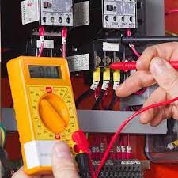





What if I have a career in mind?
What if I don’t know what I would like to do in the future?
Notes:
I have spoken with many year 9s who have an idea about the career they want to pursue. It is excellent to start thinking about this, however it is also fine if you don’t know what you want to do yet. The good news is that the EBACC subjects that we choose for you keep all doors open. You don't need to worry about a career when choosing your final option. If you want to be a professional musician and you love Music, fine. But the priority is to choose a subject you love. It will be the only opportunity for you to do something practical or creative.
You will be looking at careers in PSHE next term.

Slide 27
Next steps…
Think about the subjects you enjoy and would consider studying at GCSE.
Discuss your option choices with parents, carers, teachers, siblings – talking things through can help you come to a decision.
Complete the option choices form for submission by the deadline date – Friday 27th February.

Slide 28
What can you do after you have chosen your options?
Remain dedicated to ALL of your studies.
Embody our seven Christian values.
Seek support in compulsory subjects that you find challenging.
Ask teachers for independent study and revision tips – it is best to work on these now so you are already in excellent habits before you start your GCSEs!
Strive to succeed as we work towards the end of Year 9 exams.

Slide 29

Parent Workshops
6th March
27th March
Notes:
STR -Parent workshops 6th March.
Mr O’Leary (Head of English) :Reading and supporting your child in English
Mrs Dowsett (SENDCo) : Online Safety
Mr Hughes (RET Lead Science Adviser): How to support my child with ADHD/ADD (Attention Deficit Hyperactivity Disorder/Attention Deficit Disorder) (Dave needs to confirm his availability)
Miss Brown (Head of Year 10): Effective Revision Strategies
Mr Bay: Historic things to do in the South East
Andrew Hampton – seminar – 27th March – Parenting teenage boys. 6pm. Book tickets £5– sent home by email.

Slide 30

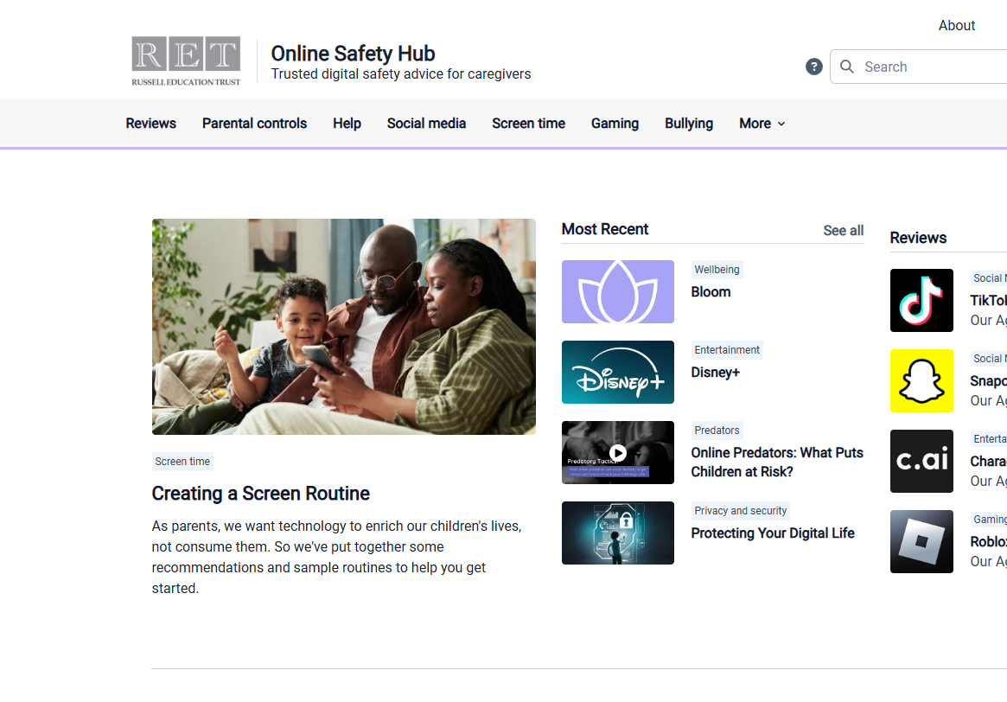
Online
Safety
Notes:
Our partnership with Qustodio offers parents free access to the Qustodio parental app. Manage screen time and monitor online activity.

Slide 31

Options@becketkeys.org
Notes:
We now have time for questions. Please do ask any general question that you think will be relevant and will be of interest to everyone here tonight. If your question is more specific to your son or daughter, please use the options email address in the letter sent on Friday. These emails will be read by me and and distributed to the right person in school to answer as soon as we can.
This presentation is being recorded, and you can watch it again at your convenience once we have uploaded it to the website after this evening.

