Slide 1
Sugarloaf Ski Trip March 27th – 3rd April 2026
Wednesday 9TH October 2024
BECKET KEYS CHURCH OF ENGLAND SCHOOL

Slide 2
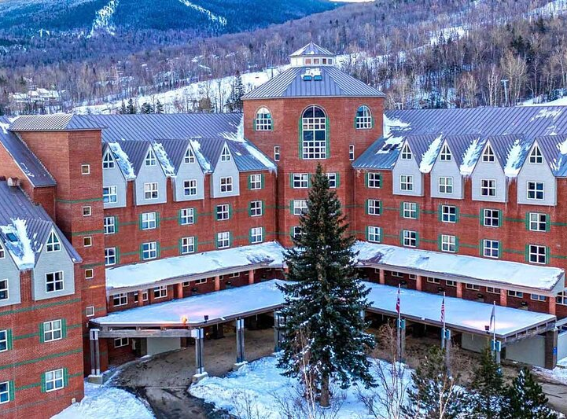
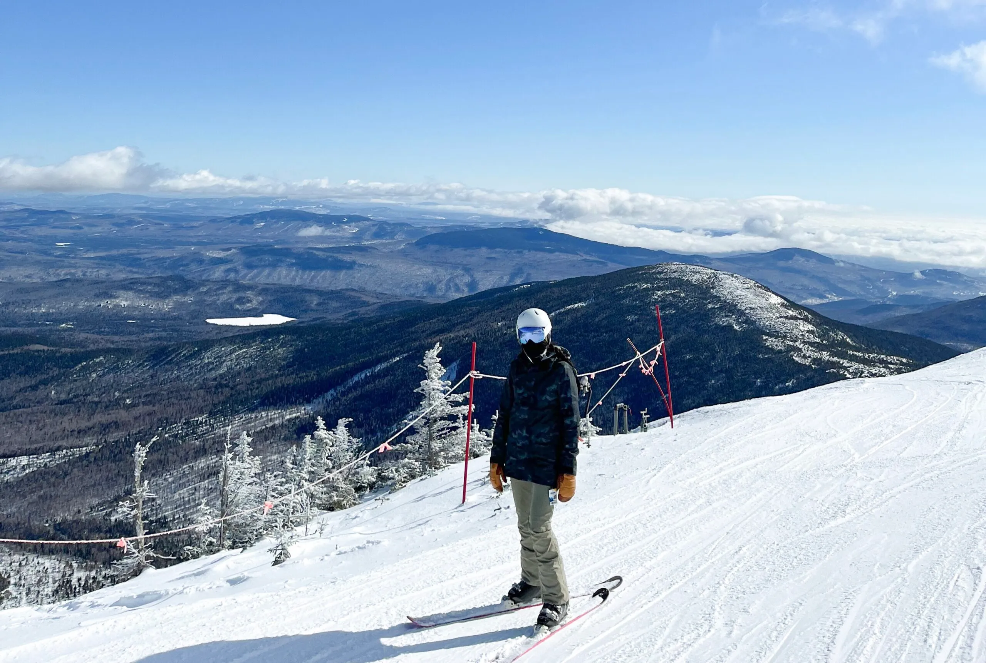

Slide 3
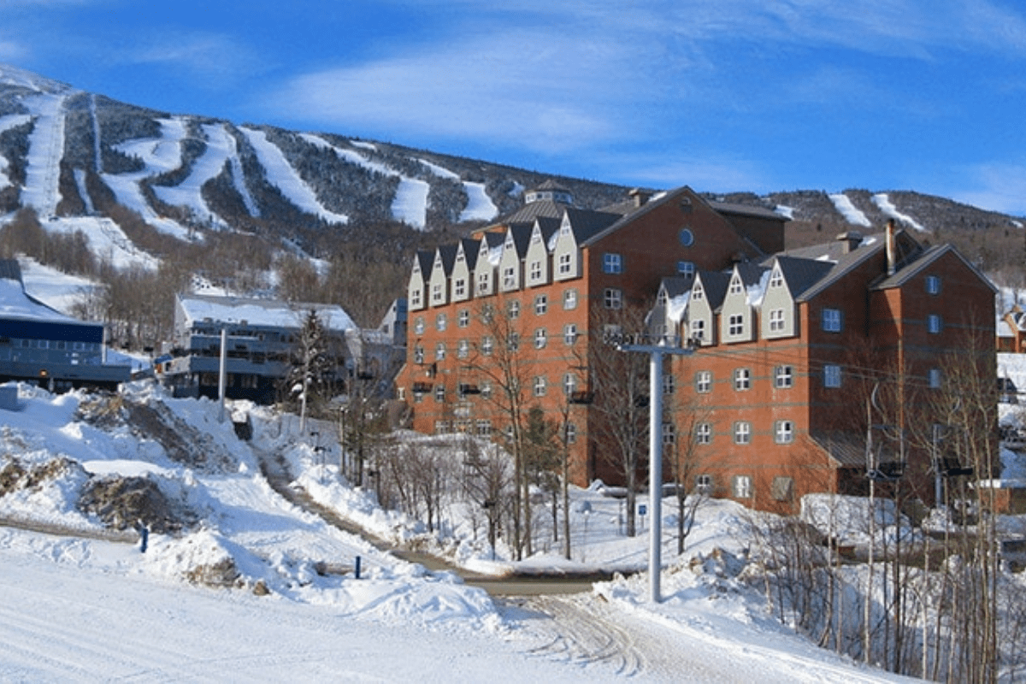
Why choose Sugarloaf?
Unique opportunity – flagship trip
Opportunity to develop independence
Excellent facilities and personalised coaching
Fantastic skiing conditions
Experienced Tour Company

Slide 4
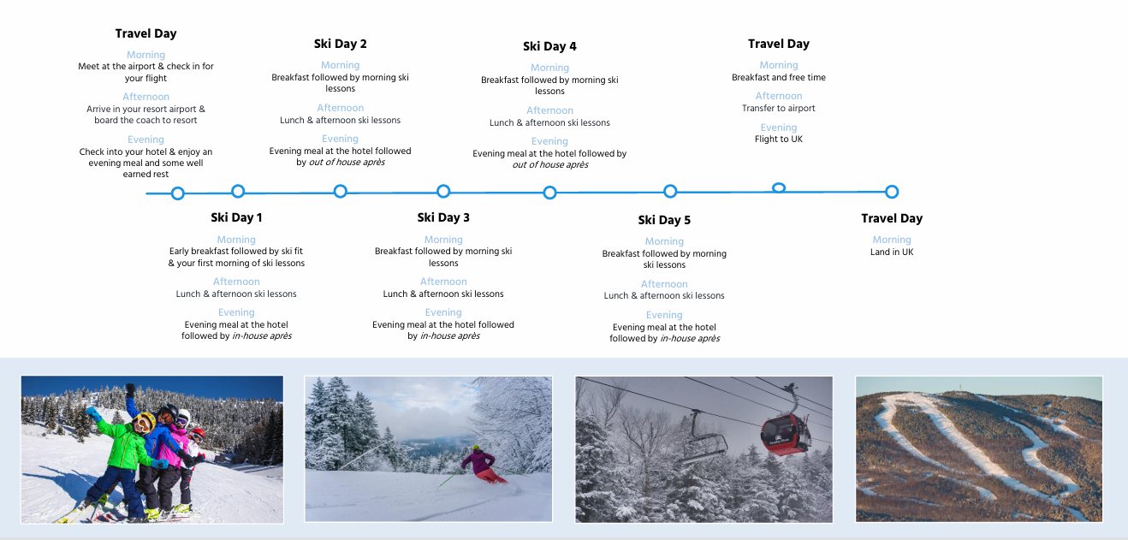
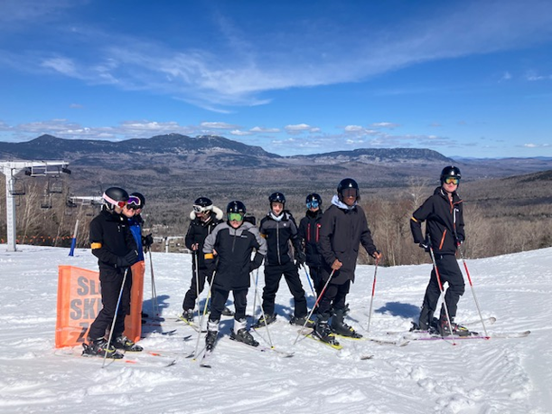
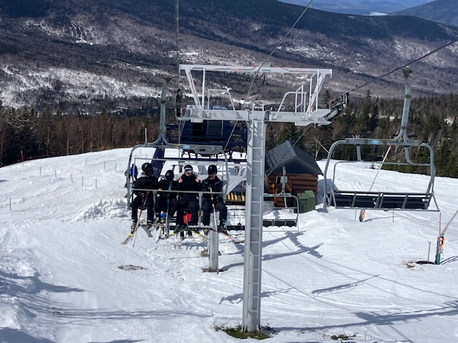
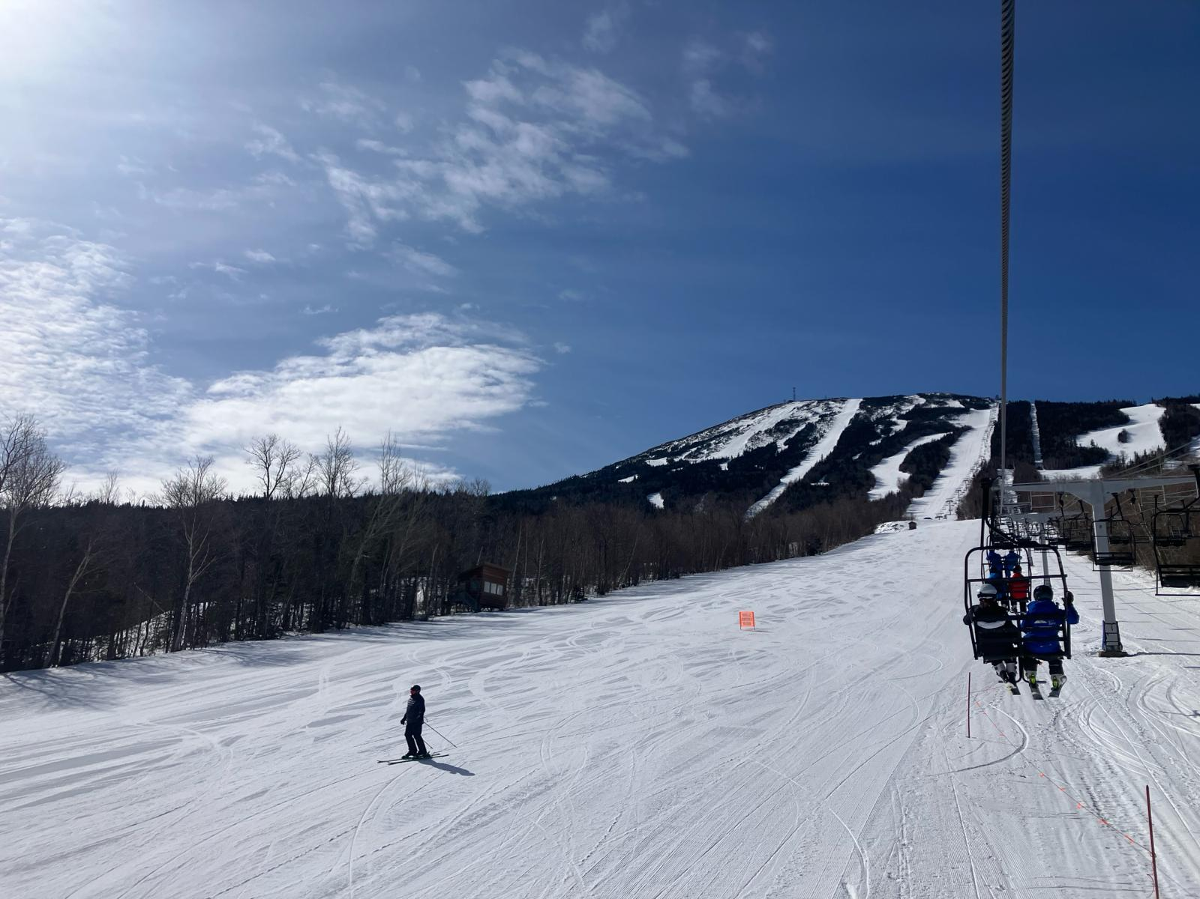

Slide 6
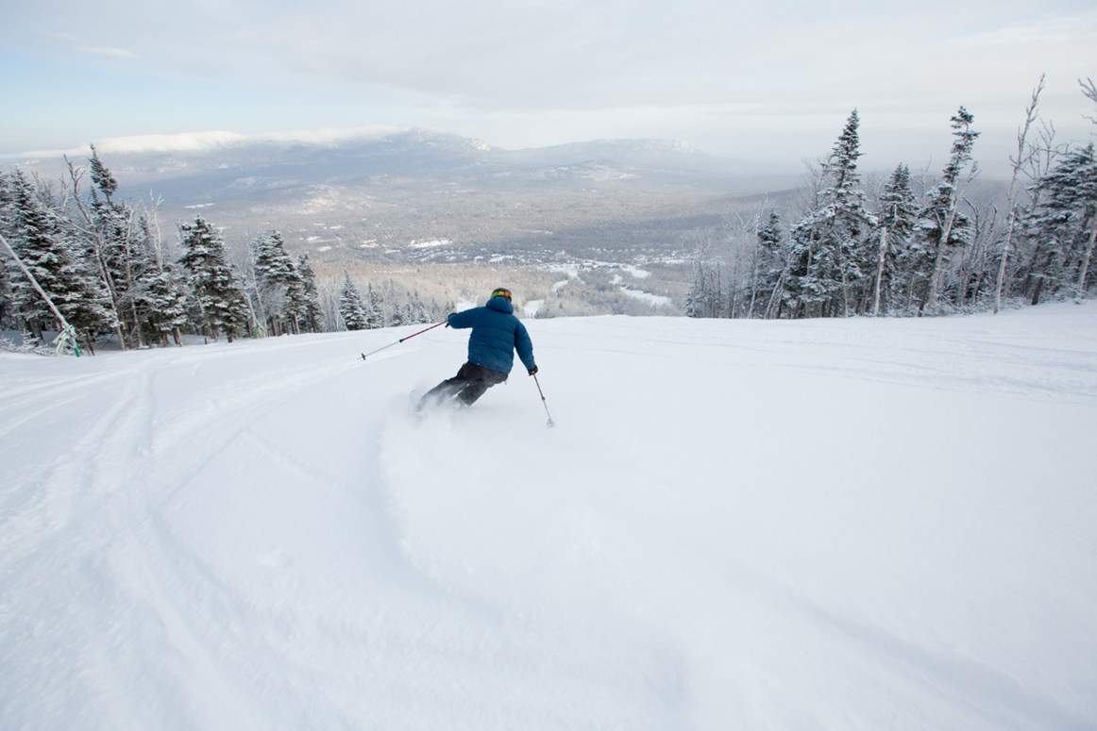
skiing
5 day ski pass
5 day ski hire including skis, boots, poles and helmets
At least 4 local ski instructors dedicated to our group, each providing a minimum of 25 hours of instruction (5 hours per day)
Convenient piste side storage

Slide 7
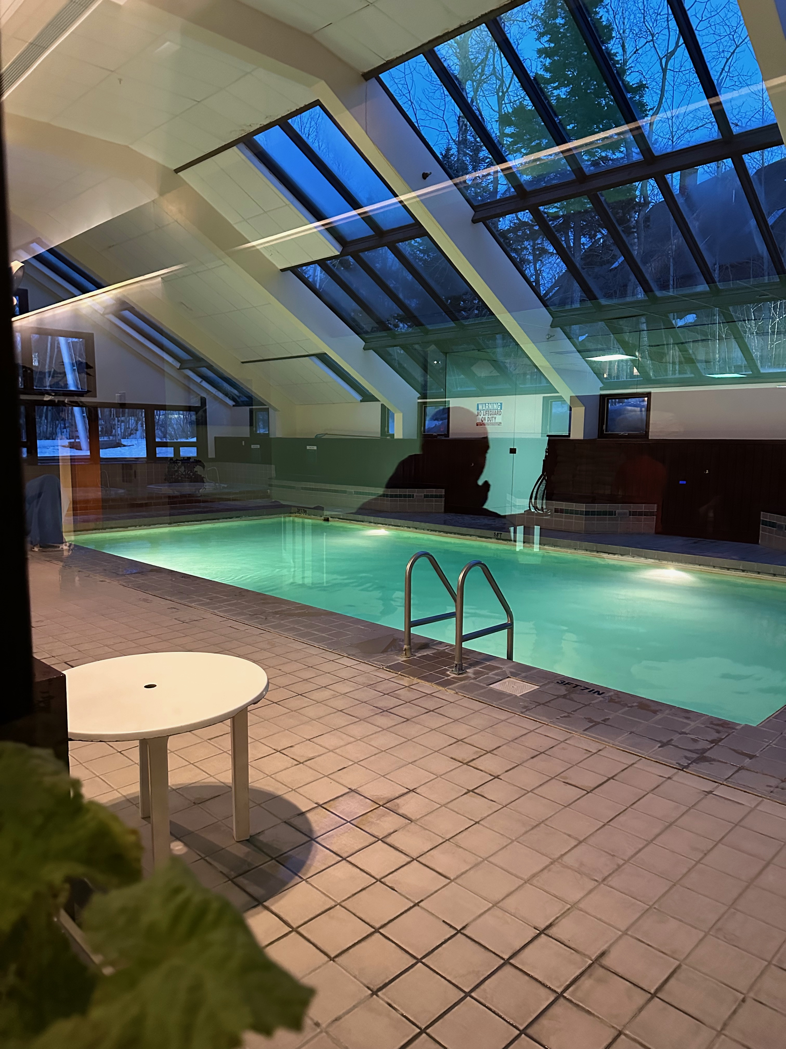
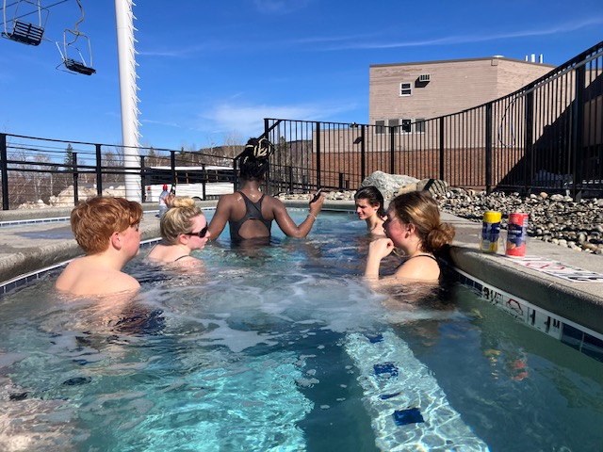
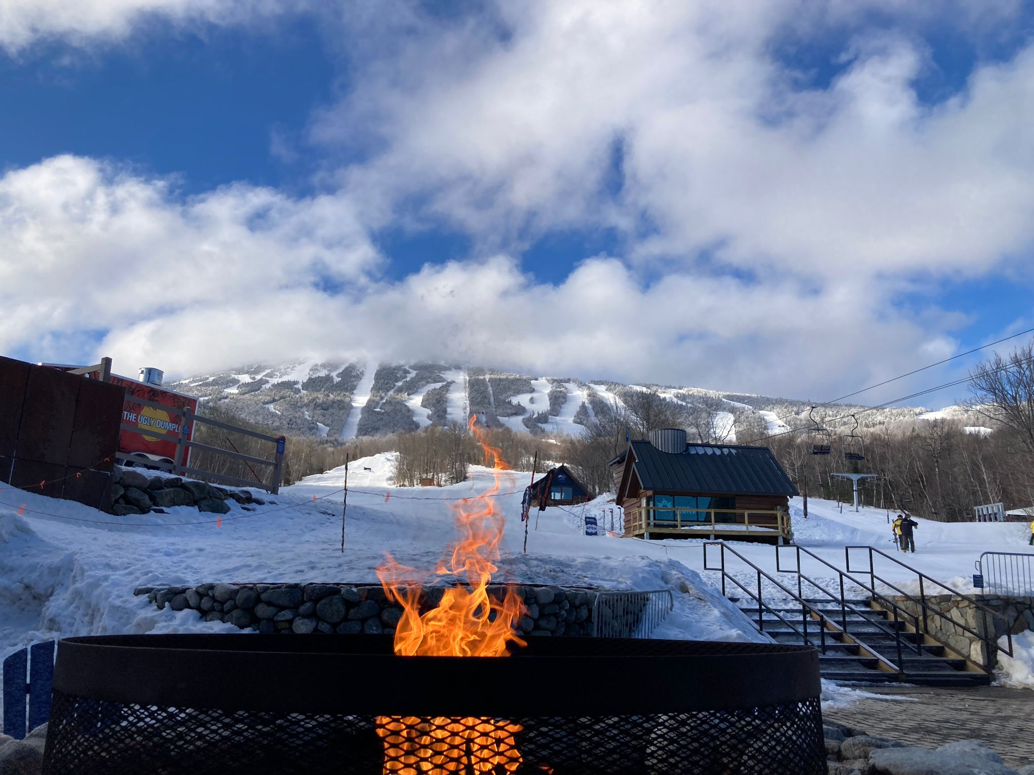
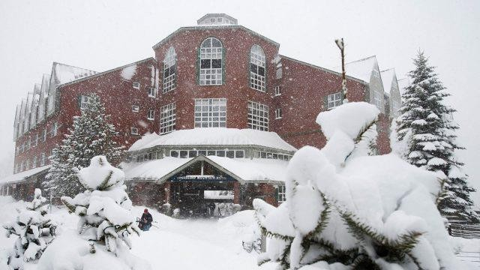
Accommodation: Sugarloaf Mountain Hotel
The Sugarloaf Mountain Hotel is a piste side hotel in the style of a classic mountain lodge.
Piste side hotel
Quality accommodation
Outdoor hot tub
Restaurant on site

Slide 8
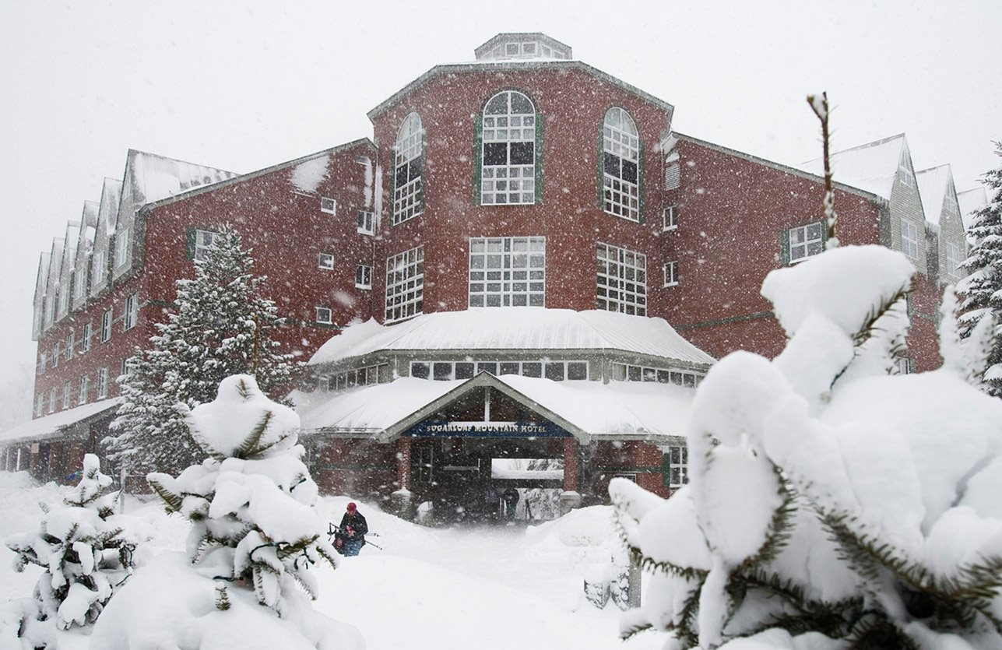
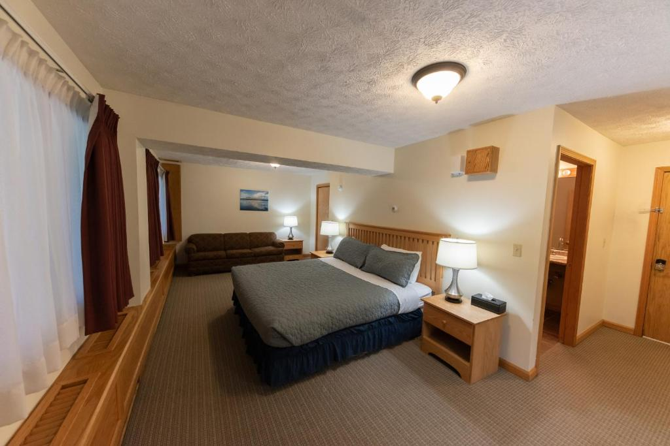
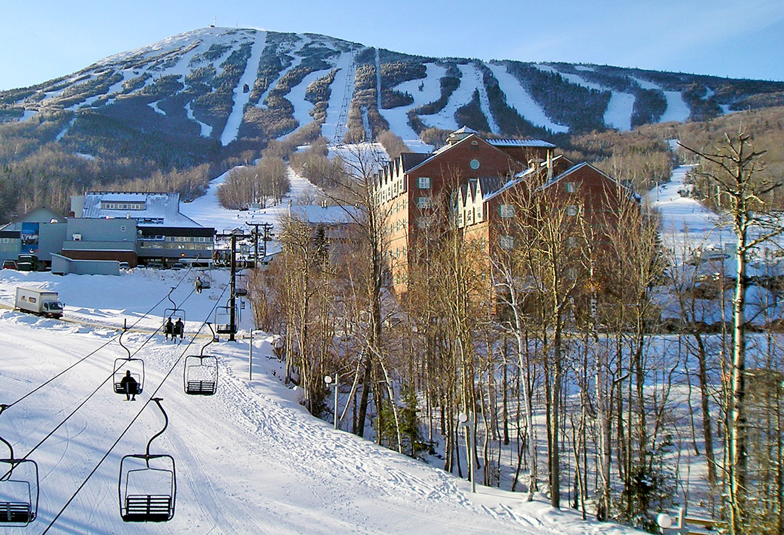
Rooms
Twin Rooms for 2 or 4 students
Huge USA-King-Size Beds
Wi-Fi​
TV/DVD in every room​
Large en suite for every room
Sofas, chairs, own lounge area, mini kitchen​
Plenty of storage space
Outstanding views of the mountains

Slide 9
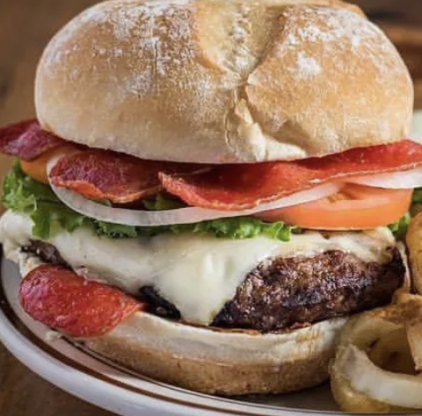
FOOD
Own restaurant area for our school with dedicated staff.
Half board basis provided by Sugarloaf Mountain Hotel
All medication and all dietary requirements are thoroughly catered for. USA understand allergies!
Great food – very popular with students.
Huge array of choices and plenty to fill up on!
Lunch is purchased from the cafes around the bottom of the slope. Huge variety to suit different tastes and appetites.
Minimarket and vending machines also available for hungry teenagers who finds themselves needing to top up even more!

Slide 10
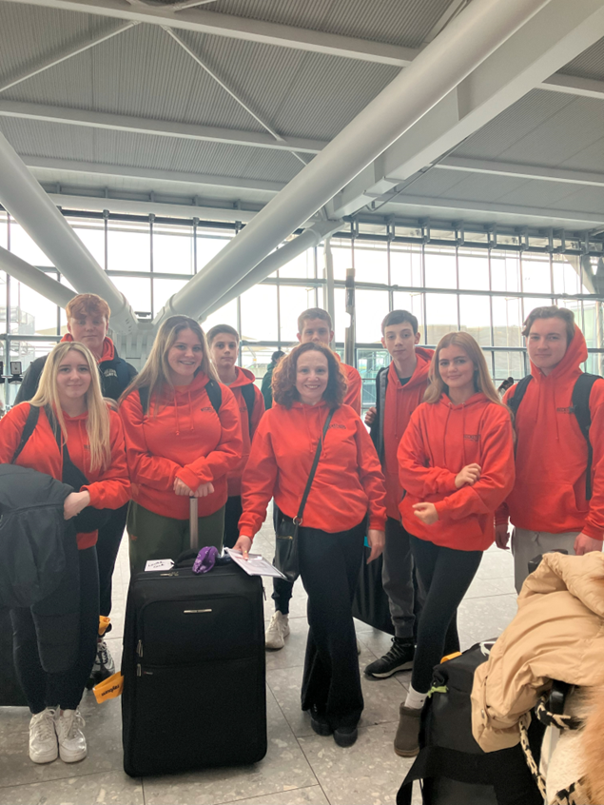
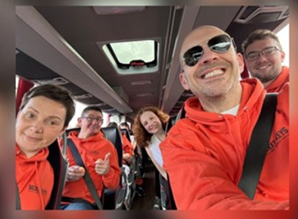
Travel
British Airways Return Flights (Heathrow to Boston)
1 piece of hold and hand baggage per person, subject to weight and dimension restrictions (huge weight allowance up to 23kg).
1 piece of hand luggage per person in line with airline requirements.
Luggage check in day before at school.
Typical long haul entertainment system in flight.
Meals and refreshments on flights.
First class coach travel (school to Heathrow, Boston to Sugarloaf – and back).

Slide 11
Après Ski
bowling trip
movie night
quiz night
sports facilities
jacuzzi
gym
lounge areas
saunas
steam rooms
fire pit

Slide 12
Payments: £2461-£2861
Payments may vary slightly depending on a couple of factors.
Over 16s have an additional £90 Air Passenger Duty
Option for sharing a twin room between 2 people and between 4 people.
Payment Type and Amount |  | Due Date
First deposit | £300 per paying passenger | 25th October 2024
Second deposit | £150 per paying passenger | 20th December 2024
Third deposits | £150 per paying passenger | 14th February 2025
Final balance | Remainder of balance | Ten weeks prior to departure (roughly £150 per month)

Slide 13
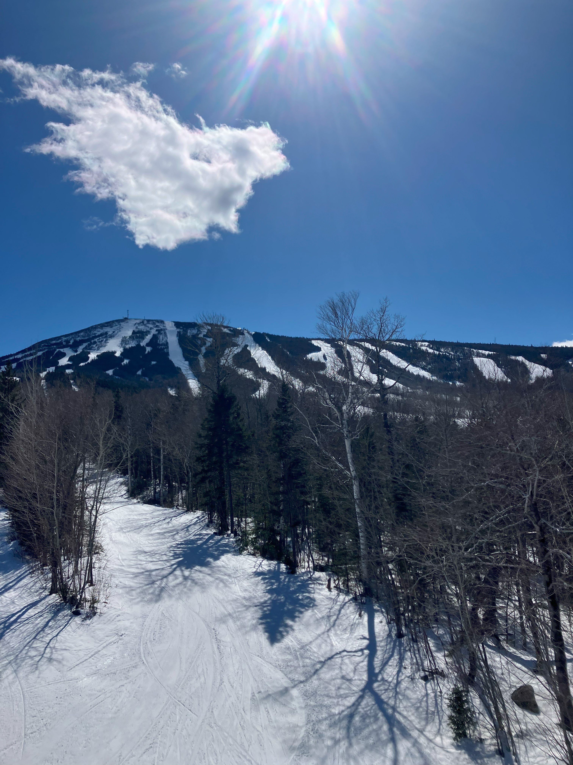
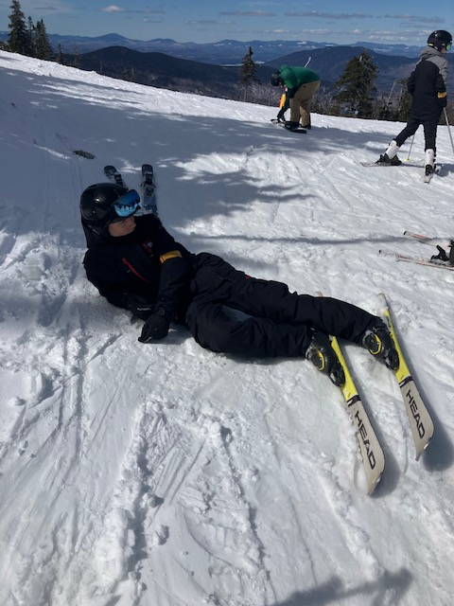
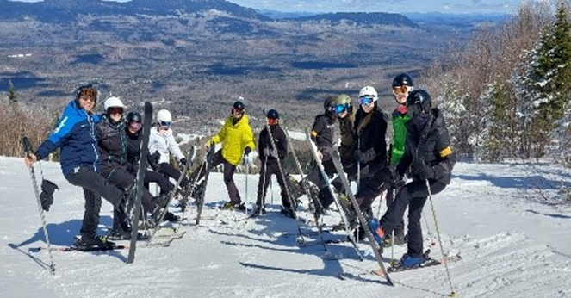

Slide 14
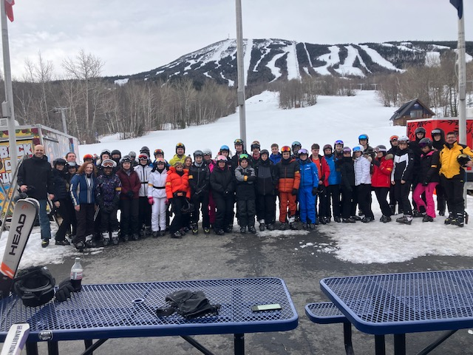
Any Questions?

