Slide 1
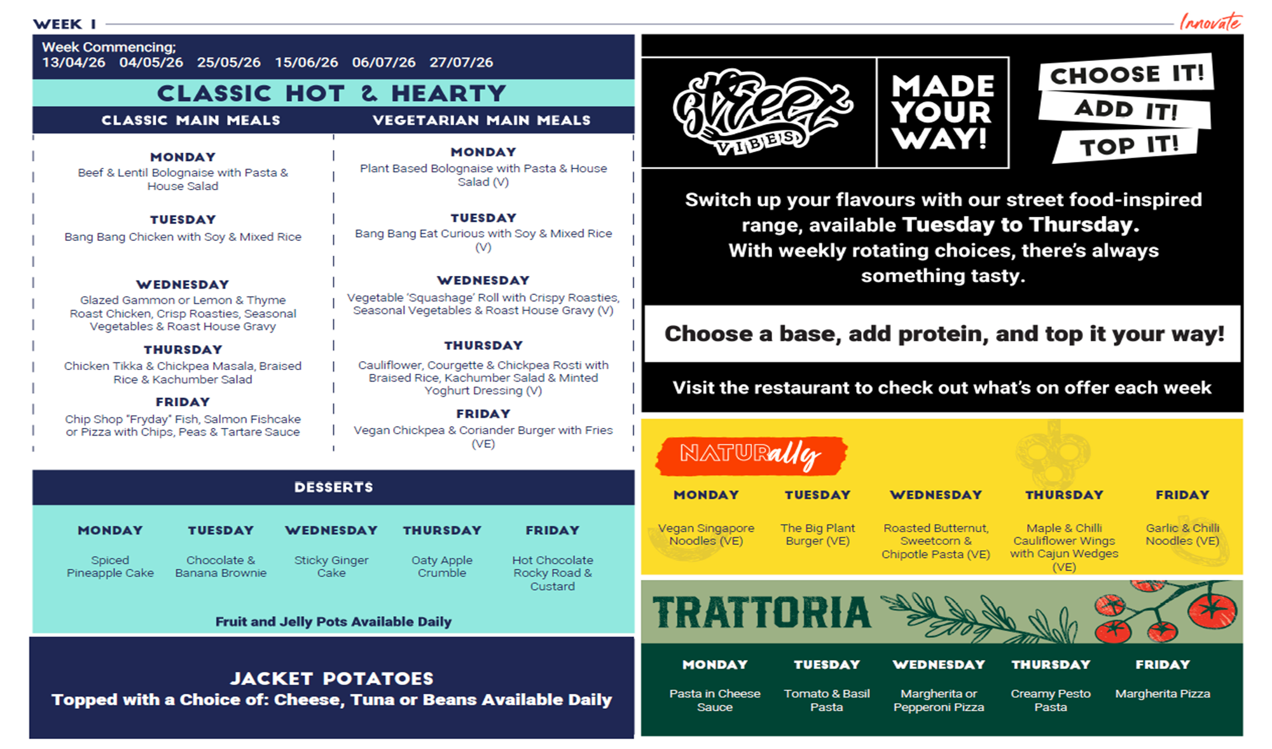
£2.85
£2.85
£2.85
Hot Bowls Prices £2.65
Free with the main meal or £1.65 if purchased individually
- Price: £1.00
Pizza from £1.60, Pasta 12oz £2.25
Prices from £2.15

Slide 2
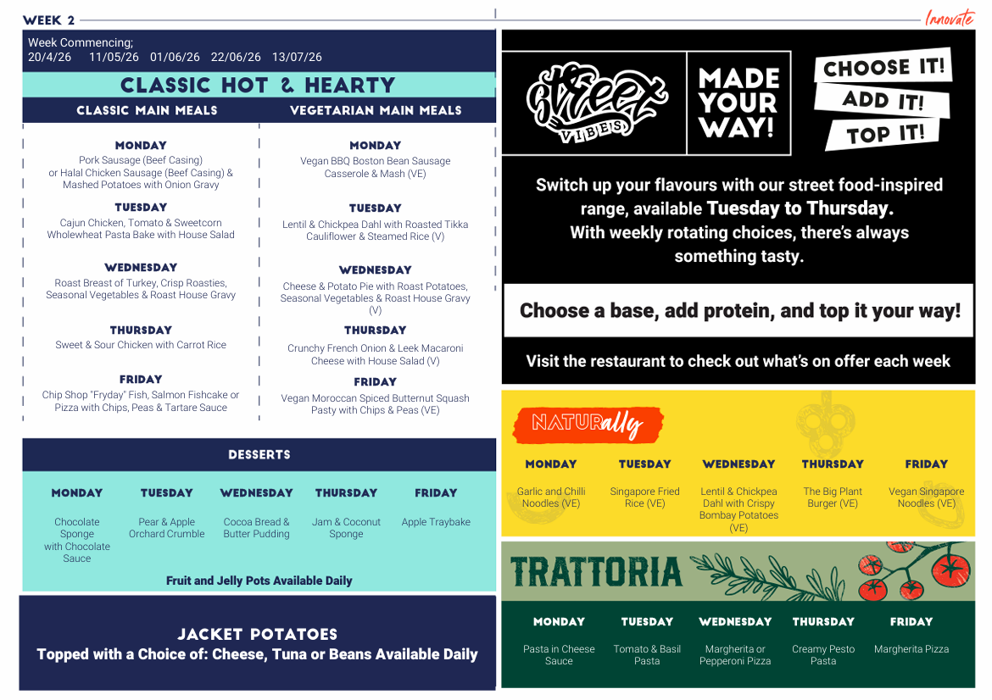
£2.85
£2.85
£2.85
Hot Bowls Prices £2.65
Free with the main meal or £1.65 if purchased individually
- Price: £1.00
Pizza from £1.60, Pasta 12oz £2.25
Prices from £2.15

Slide 3
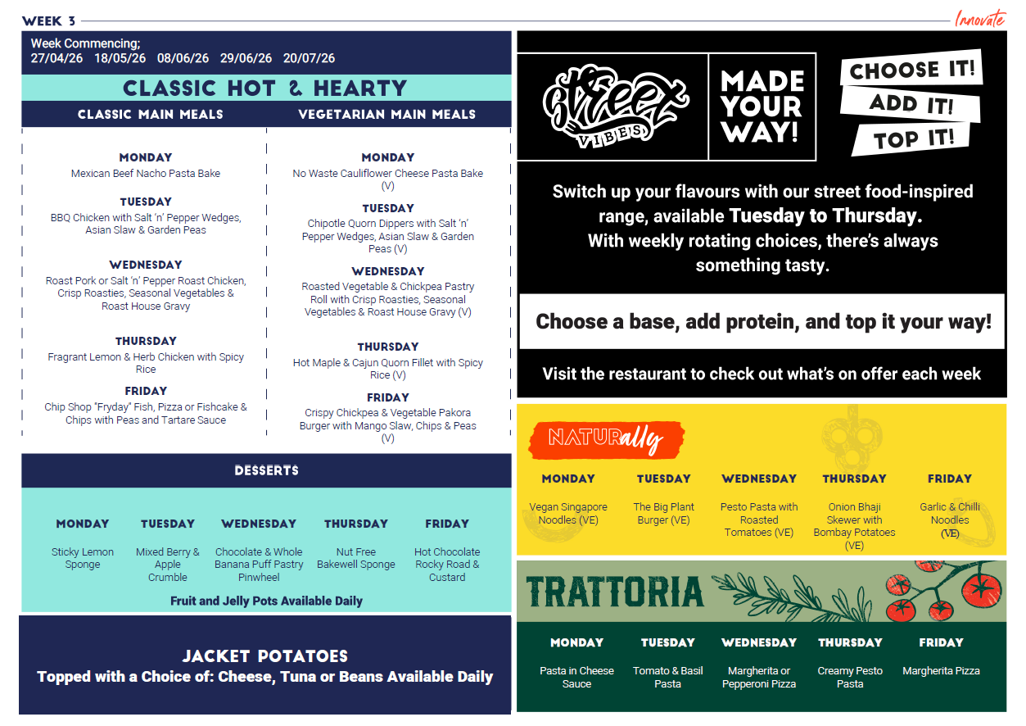
£2.85
£2.85
£2.85
Hot Bowls Prices £2.65
Free with the main meal or £1.65 if purchased individually
- Price: £1.00
Pizza from £1.60, Pasta 12oz £2.25
Prices from £2.15

